Slide 1
基於時序金字塔之第一人稱影像行為辨識 Activity Recognition in First-Person Camera View Based on Temporal Pyramid
Speaker: Hsaun-Ming Liu
Advisor: Ming Ouhyoung, Ph.D

Slide 2
Outline
Introduction
Related work
System Overview
Method
Experiments & Results
Demo
Conclusion

Slide 3
Introduction

Slide 4
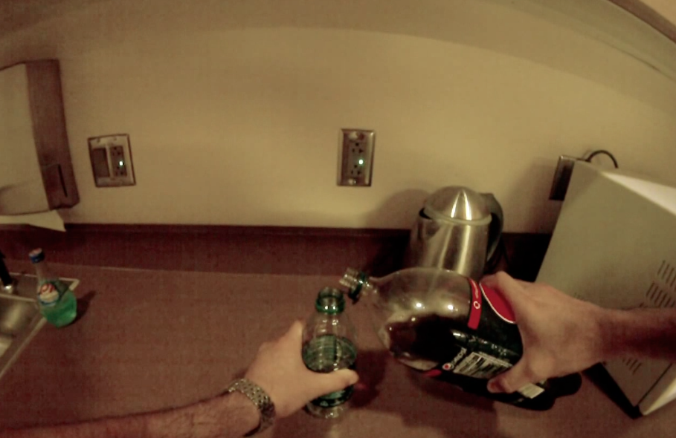

Problem Definition
First-Person-View Videos
Ongoing Activity
Notes:
當我們擁有第一人稱影片,如何去辨識畫面中主角正在從事的行為

Slide 5
Problem Definition
First-Person-View Videos
Activity of Daily Life
Eating,
Drinking,
Laundry,
etc.
Notes:
在碩論中先限縮問題範圍

Slide 6
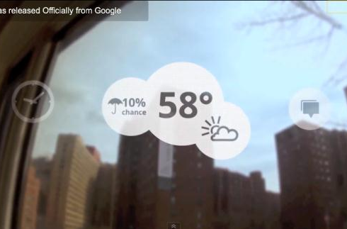
Motivation
Multimodal Context Aware Service

Slide 7
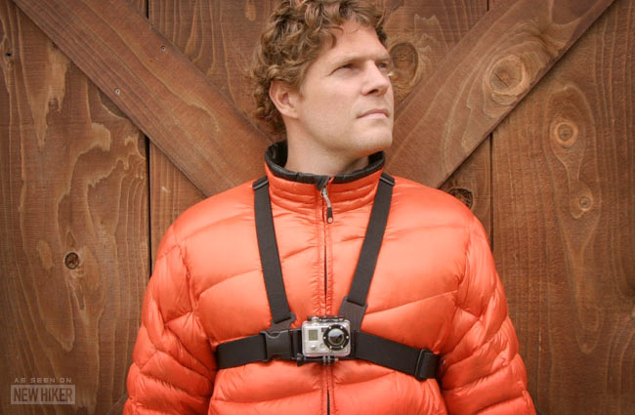
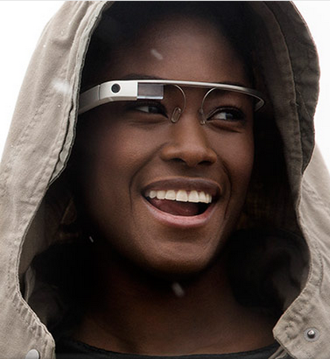
The Time has Come
Device : GoPro camera, Google Glass

Slide 8
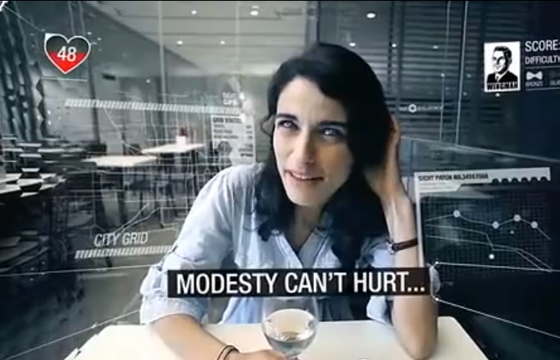
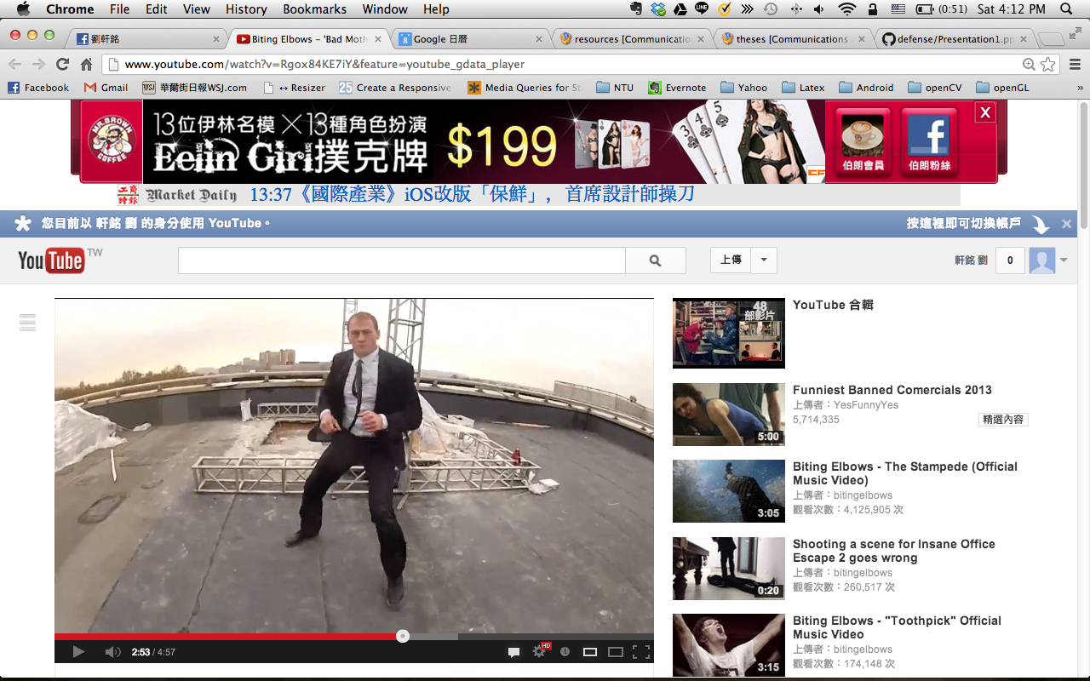
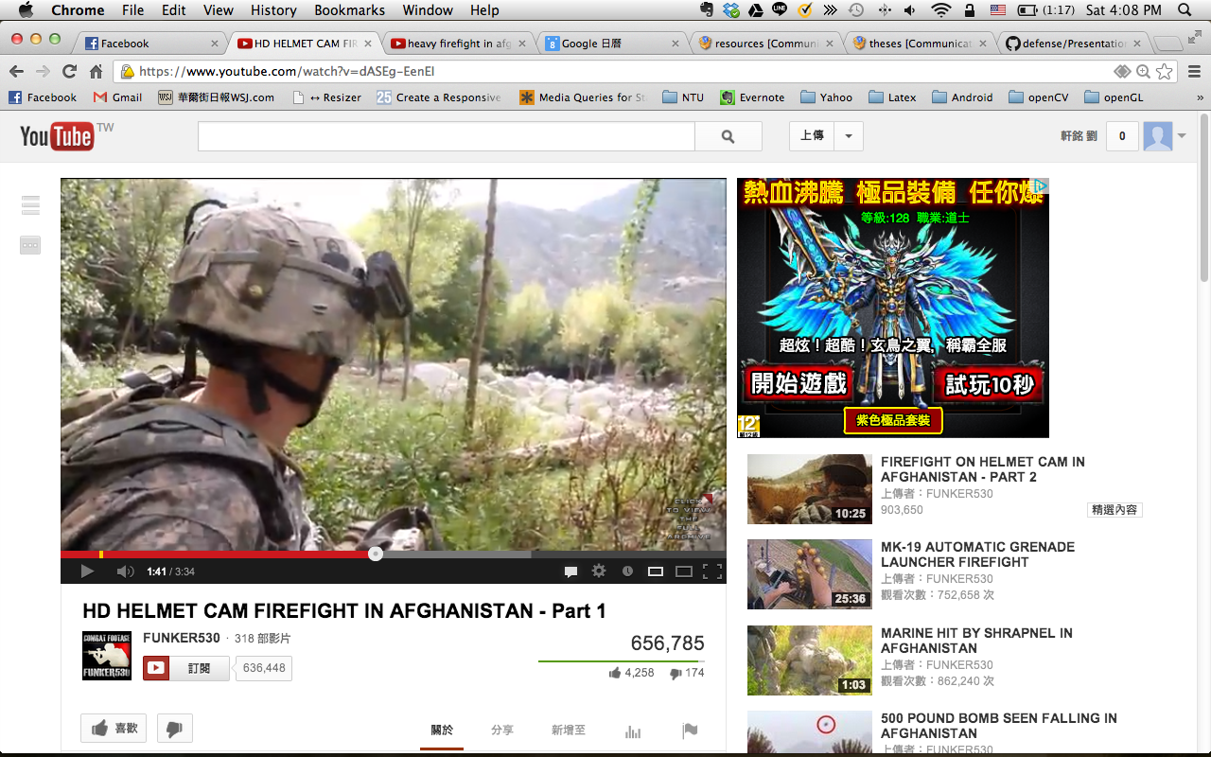
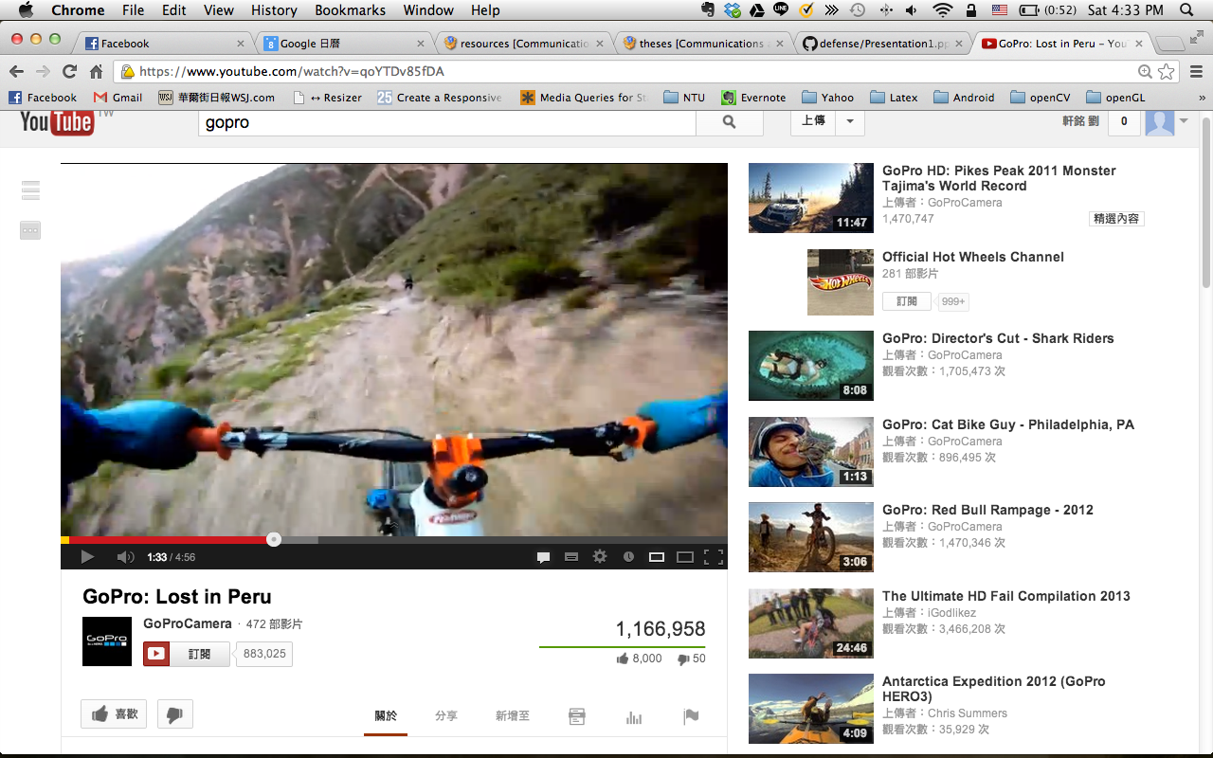
The Time has Come
Contents

